Slide 1



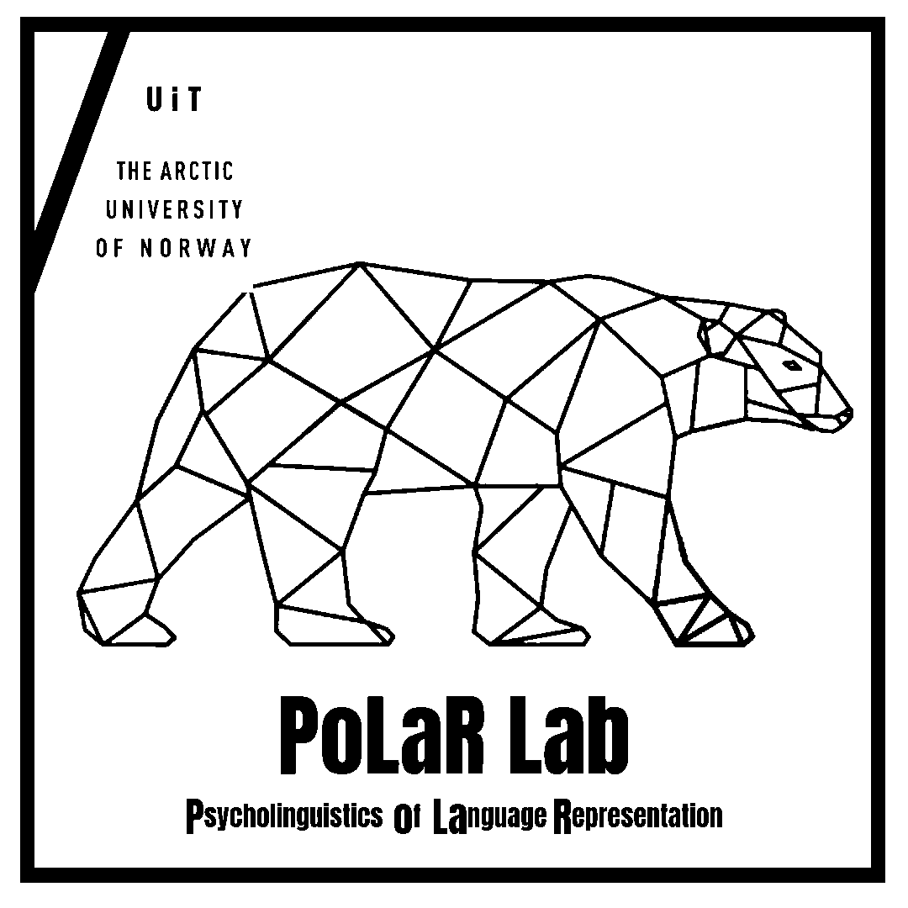


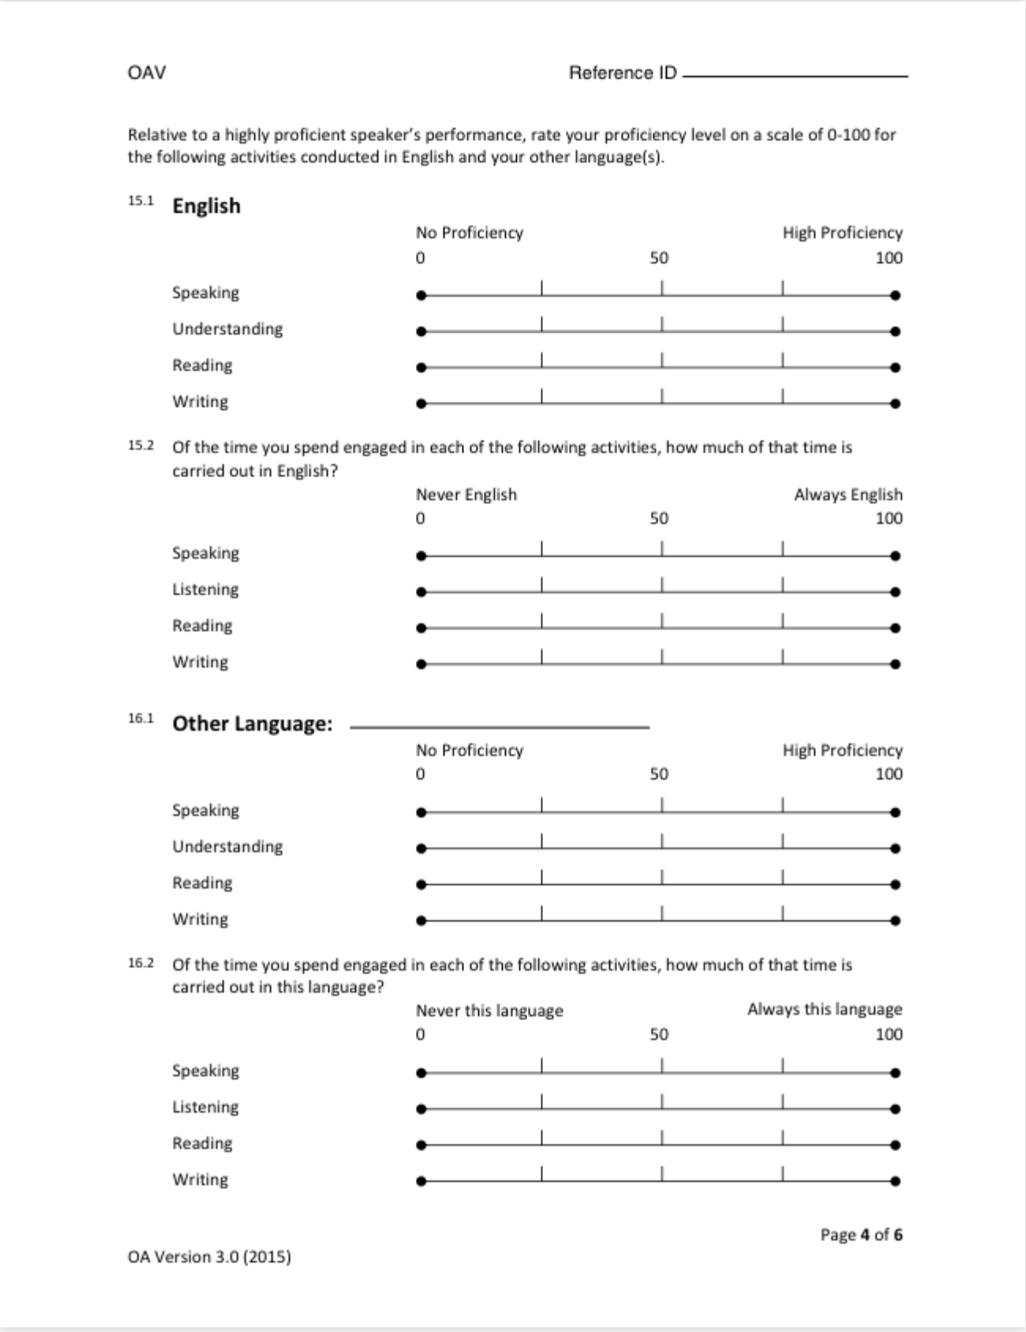

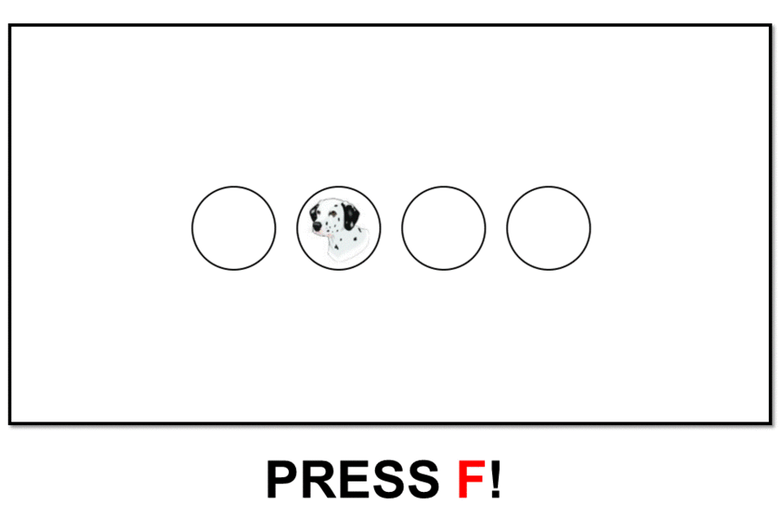



Effects of Cognitive Individual Differences on Cross-Linguistic Effects in L3 Acquisition
Gabriella Silva¹, Pablo Bernabeu², Ngoc Giang My Hoang² , Vincent DeLuca², Iva Ivanova³,
Jason Rothman^{1,2} & Jorge González Alonso^{1,2}
1. Nebrija University | 2. UiT The Arctic University of Norway | 3. The University of Texas at El Paso
Introduction
Methods
This study aims to examine the role of individual differences in cognition in L3/Ln acquisition, especially with regards to cross-linguistic influence.
The study encompasses six sessions, measuring individual differences in cognition and language history in the initial session, followed by EEG sessions designed to explore the impact of core cognitive processes on L3 acquisition, and vice versa.
Through a longitudinal approach, the study seeks to improve our understanding of the cognitive aspects involved in the multilingual learning journey.
Groups
L1 English – L2 Spanish
(Mini-English)
L1 Spanish – L2 English
(Mini-Spanish)
L1 English – L2 Spanish
(Mini-Spanish)
L1 Spanish – L2 English
(Mini-English)
Figure 1. Overview of the bilingual groups in combination with
the mini-language groups.
RESEARCH QUESTION:
How do core cognitive domains impact cross-language effects and interference of similar and different language properties in the
acquisition of a third language (L3)?
Details on bilingual groups
L1 English (heritage) – (child) L2 Spanish
L1 Spanish – (non-child) L2 English
Materials
EEG task
Cognitive Tasks
Stroop Task
Forward
Backward
Language background
LHQ 3.0.
Digit Span
ASRT
After (implicit) training and testing in one of the ALs, subjects complete an ERP experiment.
RSVP paradigm, grammaticality judgement at the end.
Testing one (session 2), two (session 3) or all three properties (session 4, session 6).
Figure 2. Overview of the individual difference measures.
Figure 4. Language History Questionnaire.
Study structure
Artificial Languages (adapted from González Alonso et al. (2020))
mini-English
mini-Spanish
Gender and number agreement
Differential Object marking
Direct objects are marked with the DOM suffix -fi
For example, He buys a boxfi
Verb-object number agreement
Verb carries the infix -ba- in sentences with a plural direct object
For example, He buybas some boxesfi
Female marked with -(e)ju and male marked with -(e)zu. Plural marked with -r
For example, je(r) box is bigeju(r) and ze(r) pencil is bigezu(r)
Figure 3. Screen from the ASRT task.
Session 1
Cognitive tasks & LHQ
Session 2
Gender-Number Agreement
Session 3
Differential Object Marking
Session 4 Verb-Object-Agreement
Session 5
Cognitive retest
Session 6
(Grammarretest)
Figure 5. Overview of Artificial Language (AL) design.
References
González Alonso, J., Alemán Bañón, J., DeLuca, V., Miller, D., Pereira Soares, S. M., Puig-Mayenco, E., Slaats, S., & Rothman, J. (2020). Event related potentials at initial exposure in third language acquisition: Implications from an artificial mini-grammar study. Journal of Neurolinguistics, 56, 100939. https://doi.org/10.1016/j.jneuroling.2020.100939
Morgan-Short, K., Finger, I., Grey, S., & Ullman, M. T. (2012). Second language processing shows increased native-like neural responses after months of no exposure. PLOS ONE, 7(3), e32974. https://doi.org/10.1371/journal.pone.0032974
Rothman, J. (2011). L3 syntactic transfer selectivity and typological determinacy: The typological primacy model. Second Language Research, 27(1), 107–127. http://www.jstor.org/stable/43103852
Rothman, J., Alemán Bañón, J., & González Alonso, J. (2015). Neurolinguistic measures of typological effects in multilingual transfer: Introducing an ERP methodology. Frontiers in Psychology, 6. https://www.frontiersin.org/articles/10.3389/fpsyg.2015.01087
Funded by: Ministry of Science and Innovation, Spain (PID2021-126884NB-I00); Community of Madrid (H2019/HUM-5705); The Research Council of Norway (326487-FORSKER21).
Notes:
STIMULI, PARTICIPANTS PROFILES, 25 EACH GROUP,
INTRODUCTION: MY FOCUS ON INDIVIDUAL DIFFERENCES, SESION 1 AND RELATED TO LONJGITUDINAL AND SESION 5 AND AFTERMEASUTRE OF HOW LEARNING IMPACT INDIVIDUAL DIFFERENCE OR COGNITIVE PERFORMANCE, LARGE
STIMULI OF THE TASK, PROCEDURE, STROOP, ASRT, DGS,
HYPOTHESIS:

